Slide 1
Applying Machine Learning Algorithms in Python for Fraud Detection in Financial Transactions

Slide 2
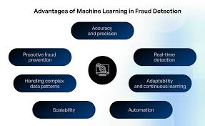
Introduction
Increasing frequency of financial transactions worldwide.
Rising financial fraud cases across industries.
Machine learning as a solution for effective fraud detection.
Notes:
With the rise of digital transactions, financial fraud has become more sophisticated. To combat this, advanced machine learning systems in Python can help detect fraud in real time, protecting businesses and consumers while minimizing losses.

Slide 3
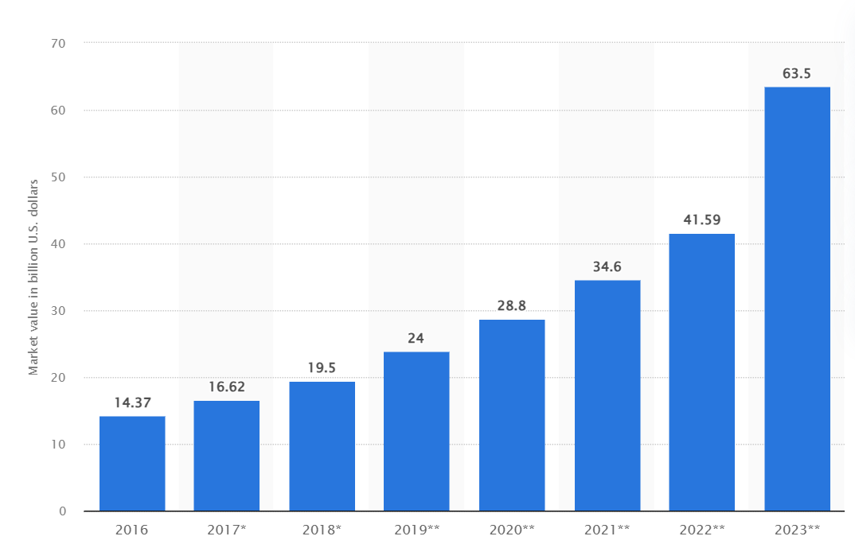
Research Aim & Objectives
Aim: Apply machine learning algorithms in Python to detect fraud.
Objective 1: By Understand prevalent fraud schemes in financial transactions.
Objective 2: Develop and evaluate machine learning models for fraud detection.
Notes:
The research aims to explore and apply machine learning algorithms for detecting fraud in financial transactions. By understanding existing fraud patterns and evaluating machine learning models like Random Forest, Decision Trees, and Logistic Regression, we can assess their effectiveness in identifying fraudulent activities. This will help refine fraud detection systems and enhance their real-time performance.

Slide 4
Research Questions
What are the practical applications of machine learning algorithms in fraud detection during financial transactions?
What are the benefits of implementing machine learning algorithms in financial fraud detection?
What are the limitations with implementing machine learning algorithms in financial fraud identification?
What particular model is the best and how further security can be improved using machine learning in real-time data monitoring to improve fraud detection?
Notes:
The research is guided by several key questions, such as understanding the real-world application of machine learning in fraud detection, evaluating the benefits of these algorithms, and identifying limitations. The goal is to evaluate the effectiveness of various machine learning models, determine which model performs best, and address challenges like data imbalance and overfitting in real-world applications.

Slide 5

Fraud Detection Background
Financial frauds are an increasing concern in both online and offline transactions.
Fraud detection involves identifying suspicious patterns and anomalies.
Machine learning enhances speed and accuracy compared to traditional methods.
Notes:
Financial fraud detection has evolved with the rise of digital transactions. Traditional methods have given way to machine learning, which can identify complex patterns in large datasets faster and more accurately. By using advanced algorithms, machine learning systems can continuously learn and adapt to new fraud patterns, improving the detection process in real-time.

Slide 6

Machine Learning Models Used
Random Forest Classifier
Decision Tree Classifier
Logistic Regression
XGBoost
Notes:
The research utilizes a range of machine learning models to evaluate their performance in fraud detection. Random Forest and XGBoost are ensemble methods known for their high accuracy, while Decision Tree and Logistic Regression offer simpler, interpretable solutions. Each model was trained and tested on a financial fraud dataset to assess its ability to detect fraudulent transactions accurately.

Slide 7
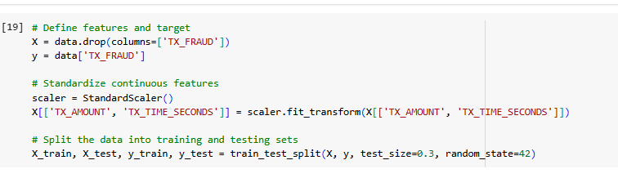
Data Preprocessing
Dataset: Kaggle Financial Fraud Detection Dataset.
Data cleaning: Removal of null and duplicate values.
Feature scaling and splitting into training and test sets.
Notes:
Before training the models, the dataset was preprocessed to ensure its quality. This involved checking for missing values and duplicates, followed by feature scaling to standardize data such as transaction amounts and time. The dataset was then split into a training set (70%) and a test set (30%) to evaluate the performance of the machine learning models.

Slide 8
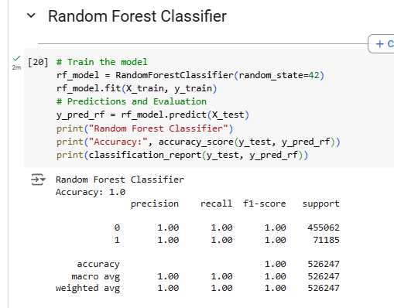
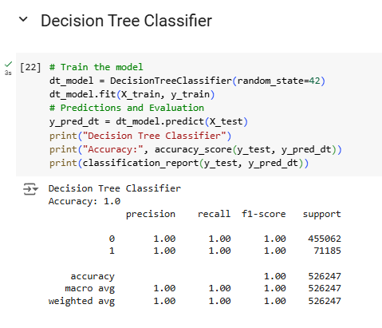
Key Results - Model Performance
Random Forest: 100% accuracy, excellent recall, and precision.
XGBoost: 100% accuracy, robust for large datasets.
Logistic Regression: 95% accuracy, good interpretability.
Decision Tree: 100% accuracy but prone to overfitting.
Notes:
The results show that both Random Forest and XGBoost models achieved perfect accuracy in detecting fraud. Logistic Regression provided a slightly lower accuracy of 95%, but it offered better interpretability, which is essential in high-stakes fraud detection scenarios. The Decision Tree also performed well but showed signs of overfitting, making it less reliable for real-world applications.

Slide 9
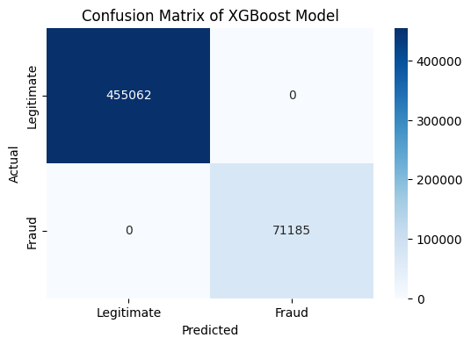
Challenges in Fraud Detection
Imbalanced dataset (fraudulent transactions are a small fraction).
Overfitting in some models, particularly Random Forest and XGBoost.
Need for real-time processing and scalability.
Notes:
One of the main challenges identified was the imbalanced nature of the dataset, where fraudulent transactions are a small percentage. This imbalance can skew results if not properly handled. Overfitting was another concern, particularly with the Random Forest and XGBoost models. Additionally, the scalability and real-time processing requirements are essential for practical deployment in financial systems.

Slide 10
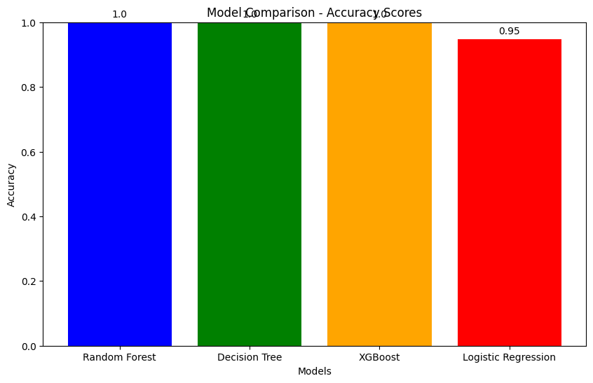
Model Comparison
Random Forest & XGBoost: Best performance, but higher resource usage.
Logistic Regression: Lower accuracy, but easy to implement and interpret.
Decision Tree: Good for small-scale applications, prone to overfitting.
Notes:
When comparing the models, Random Forest and XGBoost outperformed the others in terms of accuracy. However, they require more computational resources, which could be a limitation in large-scale applications. Logistic Regression, though slightly less accurate, is simpler to implement and interpret, making it useful in scenarios where transparency is key. The Decision Tree showed good performance but was prone to overfitting.

Slide 11
Conclusion & Future Work
Machine learning models offer effective solutions for fraud detection.
Random Forest and XGBoost are ideal for high-accuracy detection.
Future work: Explore model optimization, handle data imbalance better, and improve model scalability.
Notes:
In conclusion, machine learning models like Random Forest and XGBoost provide highly effective fraud detection solutions. These models achieve high accuracy and precision, making them ideal for financial fraud detection. Future work will focus on further optimizing these models, improving data handling techniques, and ensuring scalability for real-time fraud detection in large financial systems.

Slide 12
References
Alsuwailem, A.A.S., Salem, E. and Saudagar, A.K.J., 2023. Performance of different machine learning algorithms in detecting financial fraud. Computational Economics, 62(4), pp.1631-1667.
Alturki, R., 2021. Research Onion for Smart IoT‐Enabled Mobile Applications. Scientific programming, 2021(1), p.4270998.
Bello, H.O., Ige, A.B. and Ameyaw, M.N., 2024. Adaptive machine learning models: concepts for real-time financial fraud prevention in dynamic environments. World Journal of Advanced Engineering Technology and Sciences, 12(02), pp.021-034.
Bin Sulaiman, R., Schetinin, V. and Sant, P., 2022. Review of machine learning approach on credit card fraud detection. Human-Centric Intelligent Systems, 2(1), pp.55-68.
Hensen, B., Mackworth-Young, C.R.S., Simwinga, M., Abdelmagid, N., Banda, J., Mavodza, C., Doyle, A.M., Bonell, C. and Weiss, H.A., 2021. Remote data collection for public health research in a COVID-19 era: ethical implications, challenges and opportunities. Health policy and planning, 36(3), pp.360-368.
Itoo, F., Meenakshi and Singh, S., 2021. Comparison and analysis of logistic regression, Naïve Bayes and KNN machine learning algorithms for credit card fraud detection. International Journal of Information Technology, 13(4), pp.1503-1511.
Javaid, H.A., 2024. How Artificial Intelligence is Revolutionizing Fraud Detection in Financial Services. Innovative Engineering Sciences Journal, 4(1).
Mckinsey, 2024, Global payments in 2024: Simpler interfaces, complex reality, https://www.mckinsey.com/industries/financial-services/our-insights/global-payments-in-2024-simpler-interfaces-complex-reality

